Slide 1
Gamification of Nutrition & Healthy Eating
Presented to:
Dr. Islam El Maddah
Eng. Hala Mohamed

Slide 2
Presented by:
Abdelrahman Mohamed Zayed 23P0094 Hassan Hazem Abdelhady 23P0415 Ahmad ElSayed Abdelhafez 23P0019 Abdelmoneim Mahmoud 23P0015 Hasan Sherif Ahmed 23P0017
Zeyad AbdelMageed Saeed 23P0072 Mariam Mohamed Shemies 23P0178 Jana Mohamed Wael 23P0200 Habiba El-Sabaa Ali 23P0103 Jana Ehab Ibrahim 23P0105

Slide 3

Table of Contents
01
Introduction
02
Objectives
03
Target Audience
04
Key Features
05
User Stories
06
UML Diagrams
07
Prototype Highlights
08
Cost Estimation
09
Conclusion

Slide 4
Introduction
Rising chronic diseases (e.g., diabetes, obesity)
People need sustainable, fun, and personalized support
We aim to promote healthy habits through AI + Gamification
Notes:
Hena bntklm 3ala problem w el motivation el project aslan

Slide 5
Objectives
Personalized AI meal & fitness plans
Gamified system with badges, streaks, levels
Ingredient sourcing using geolocation
Reports and insights
Health Coach for feedback
Customized reminders

Slide 6
Target Audience
Health-conscious individuals
Busy professionals & fitness enthusiasts
1
2
3
4
Chronic condition patients
Families planning nutritious meals

Slide 7
Key Features
AI meal & fitness plan generation
Gamified rewards (points, badges)
Daily reminders & motivational messages
Ingredient sourcing via nearby store APIs
Health expert feedback module

Slide 8
User Stories
These stories guide our feature design and ensure the system is practical and personalized

Slide 9
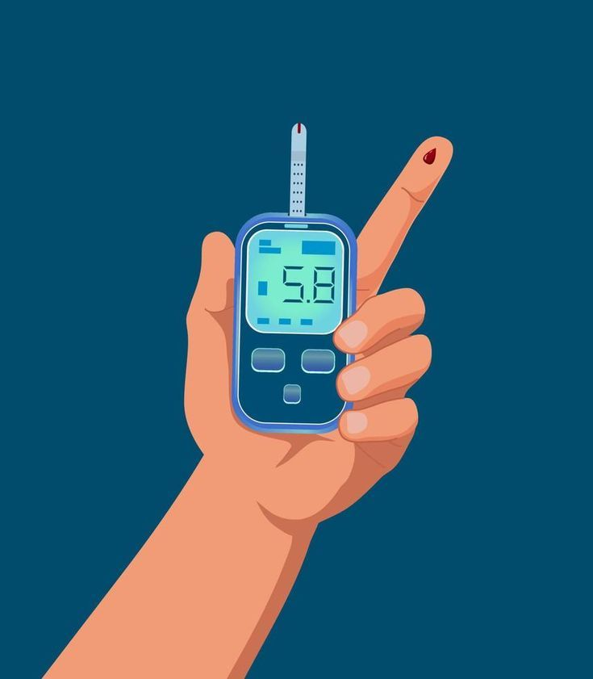
“As a diabetic, I want sugar-free meal suggestions”

Slide 10
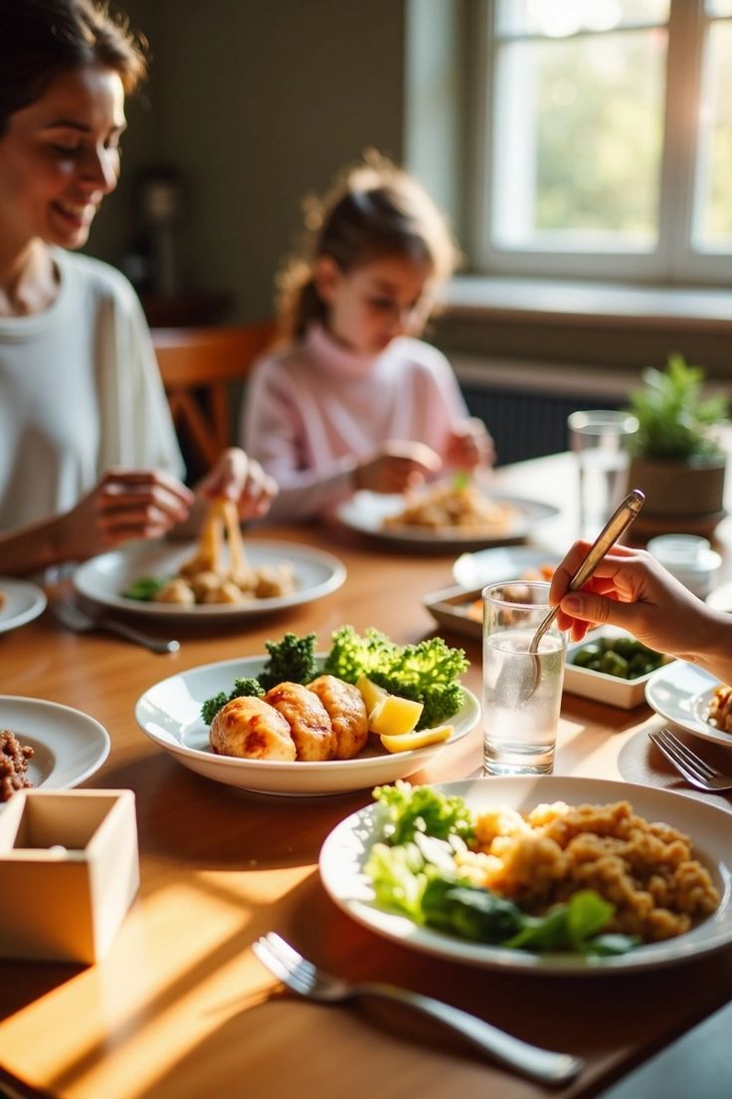
“As a parent, I want meal options that cater to children so that my family eats healthier”

Slide 11
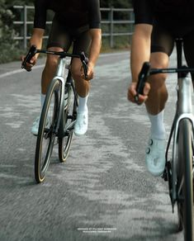
“As a fitness enthusiast, I want to see a fitness plan that complements my meals so that I reach my goals efficiently”

Slide 12
UML

Slide 13
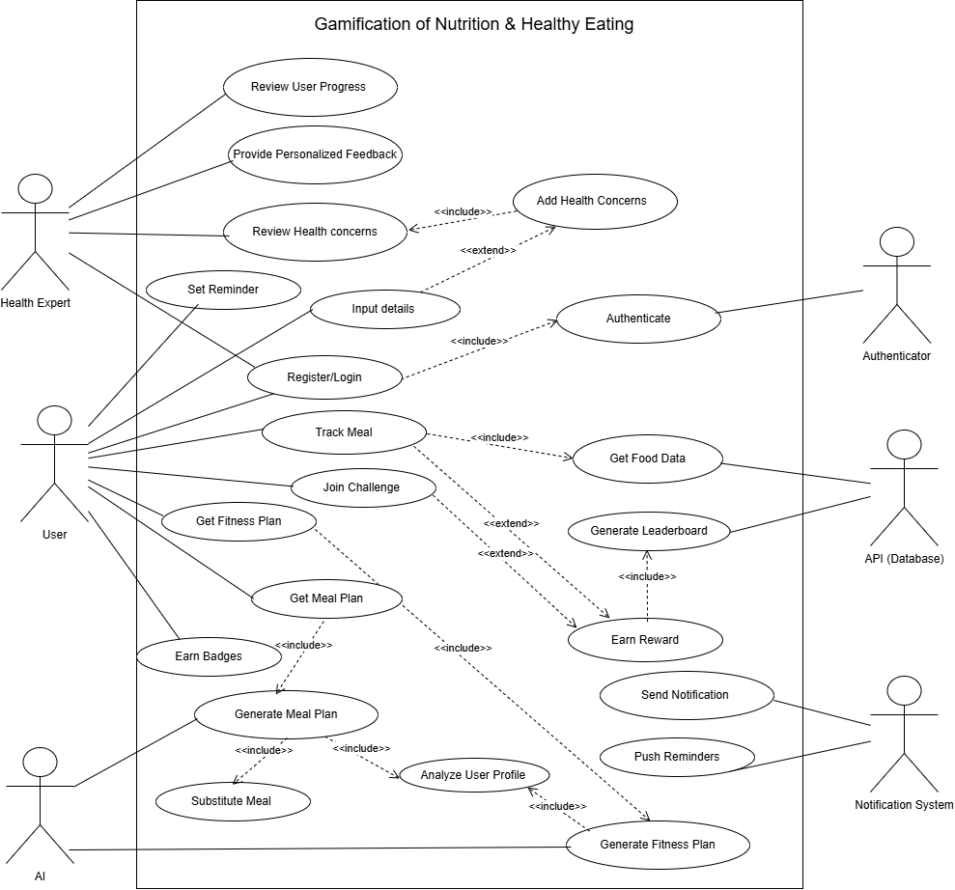

Slide 14
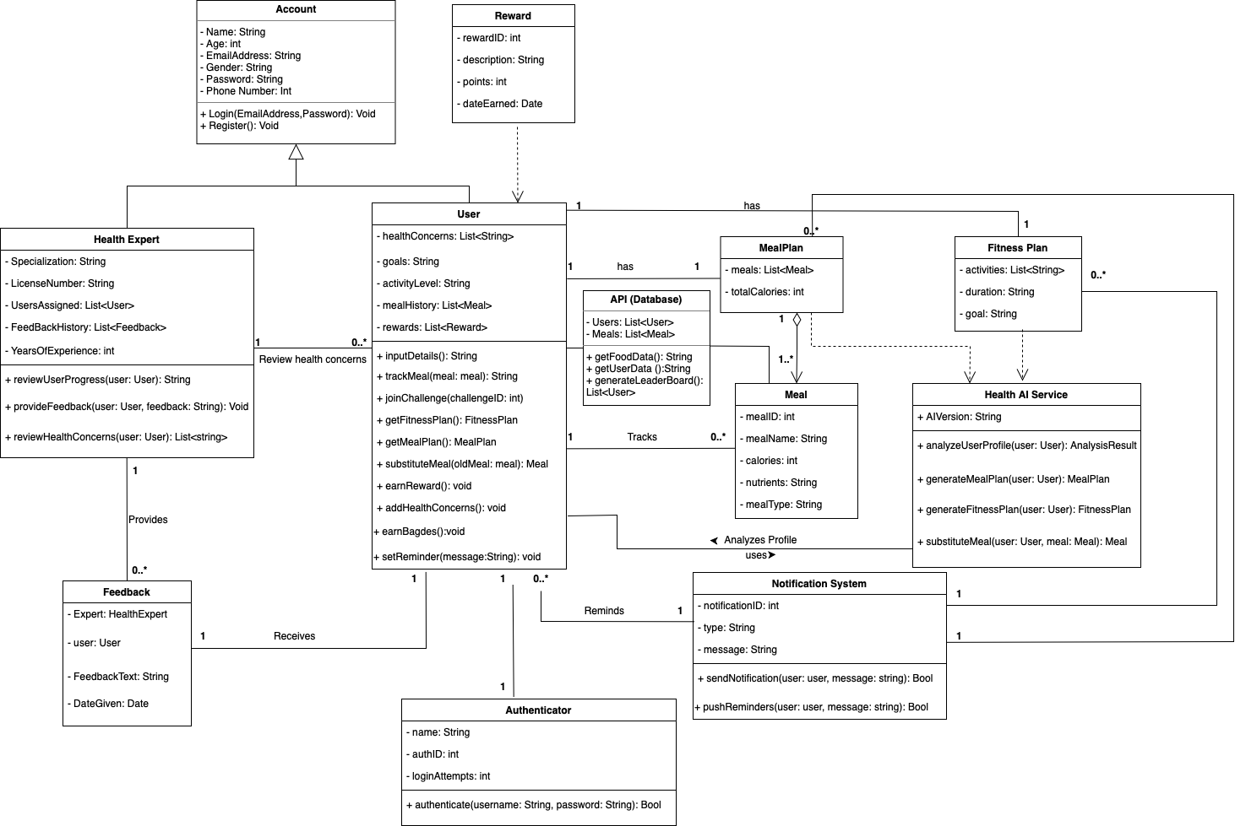

Slide 15
Prototype GUI Development

Slide 16
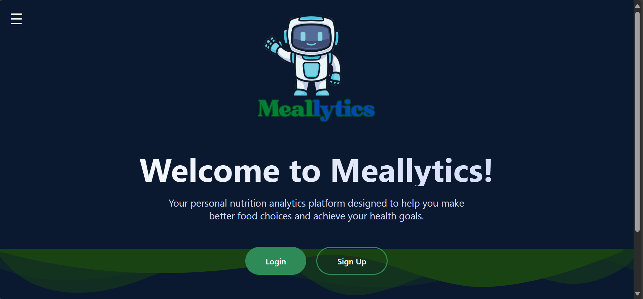
Log in/ sign up

Slide 17
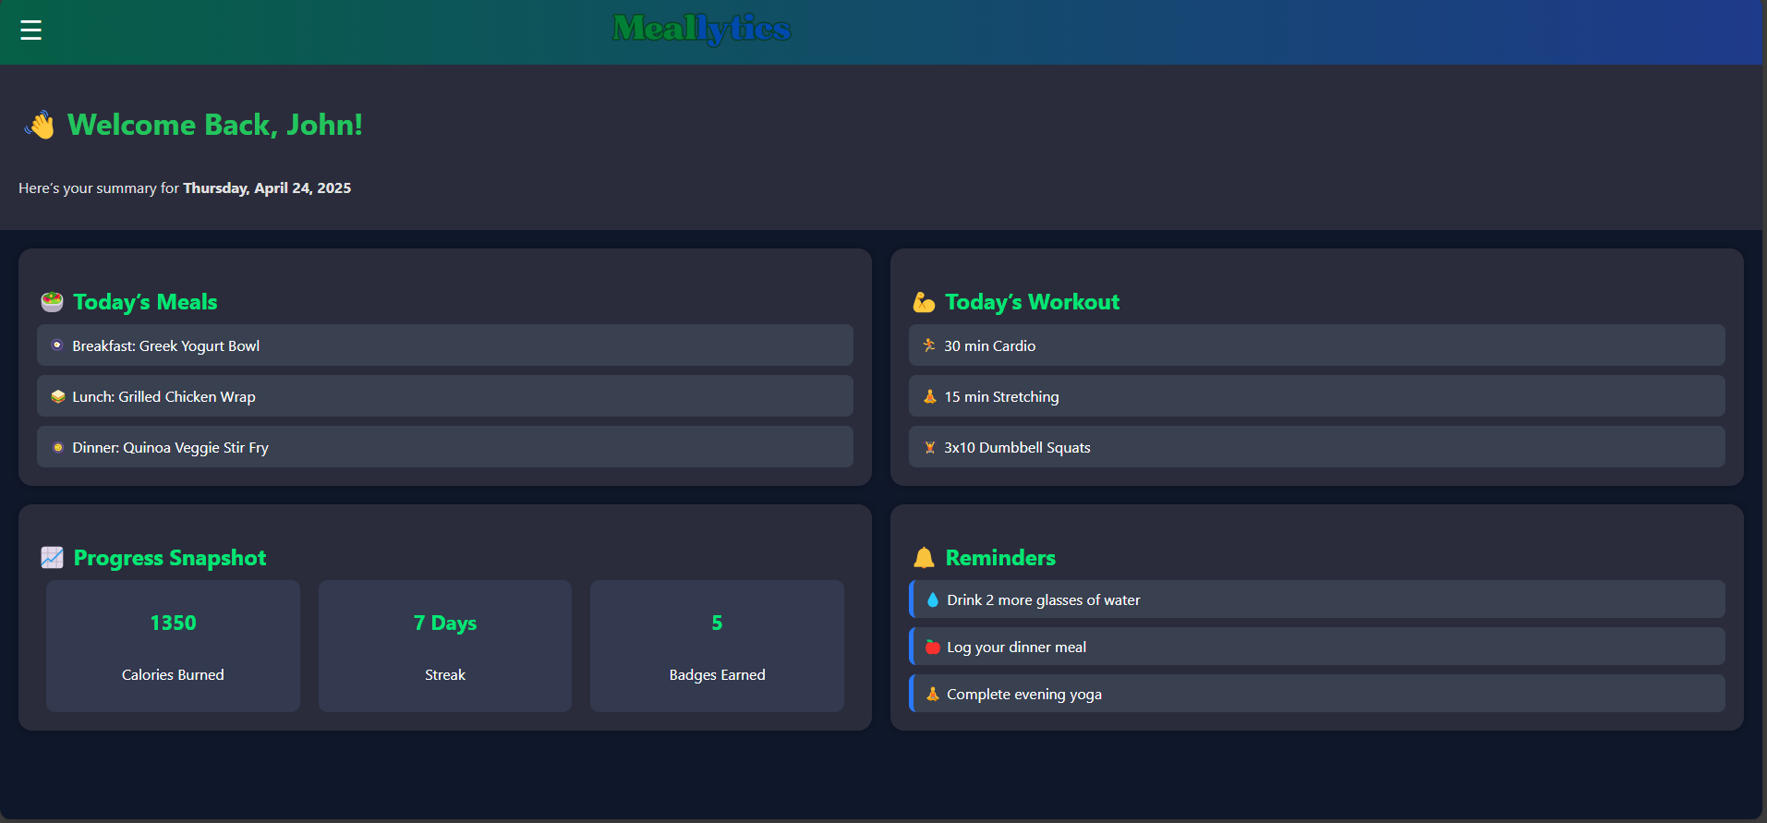
HomePage

Slide 18
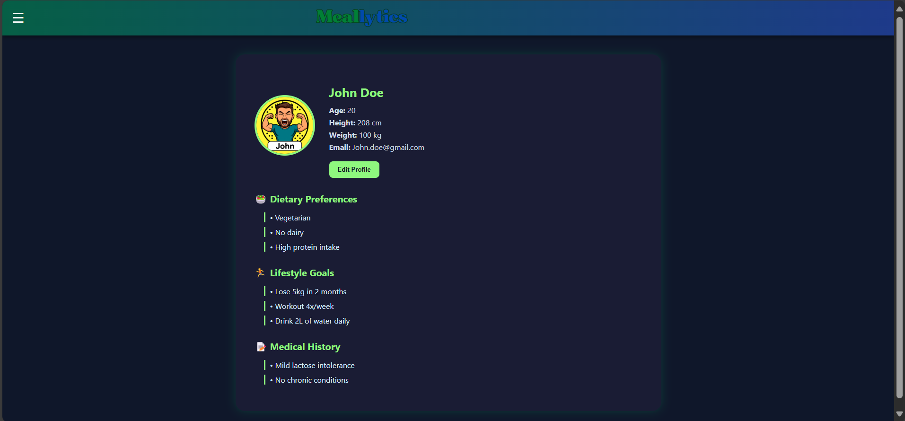
User Profile

Slide 19
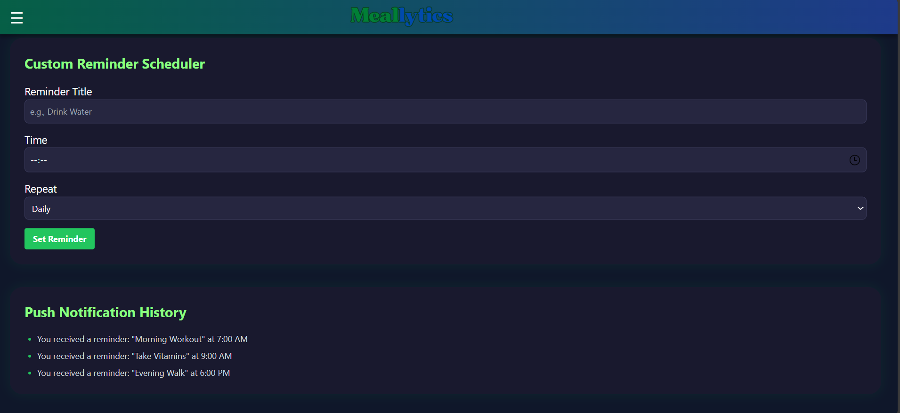
Reminders

Slide 20
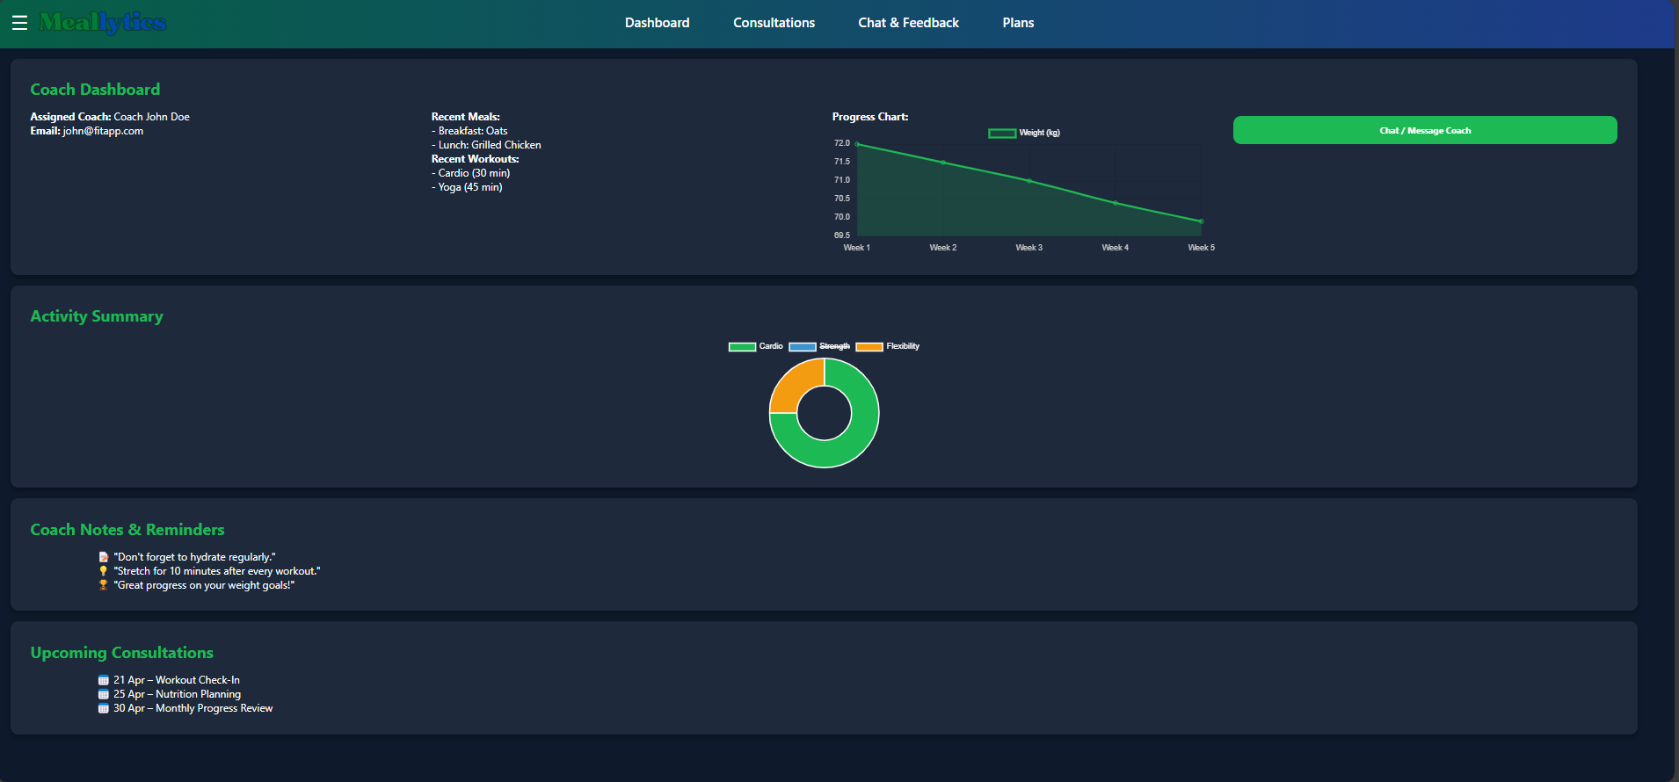
Coach Expert

Slide 21
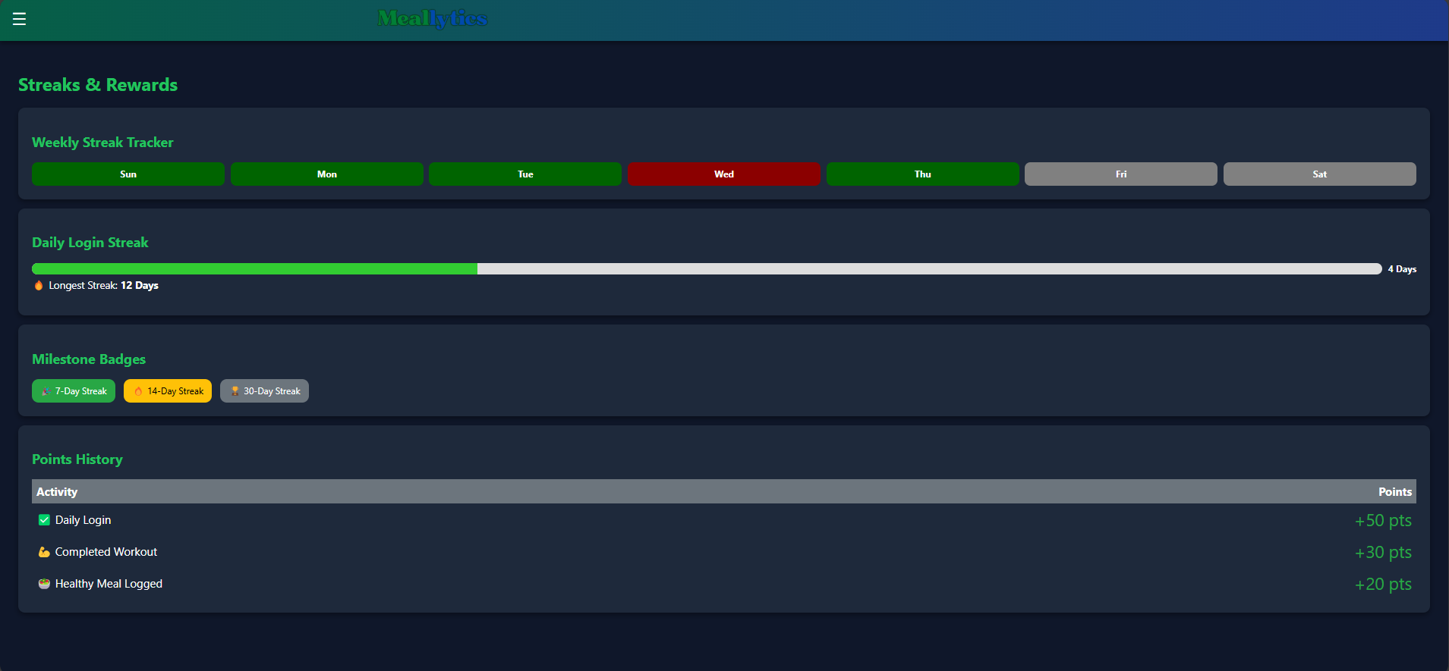
Gamification

Slide 22
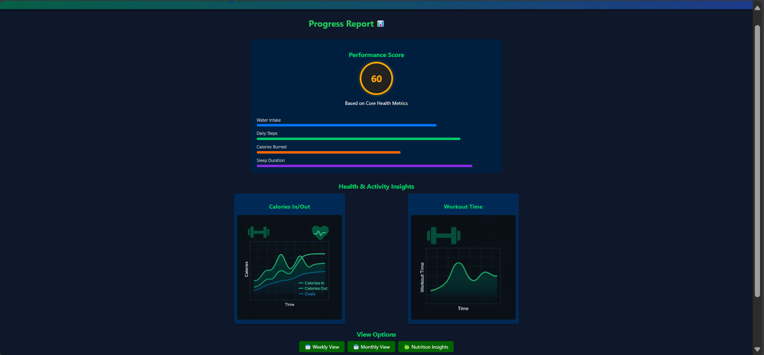
Reports & Insights

Slide 23
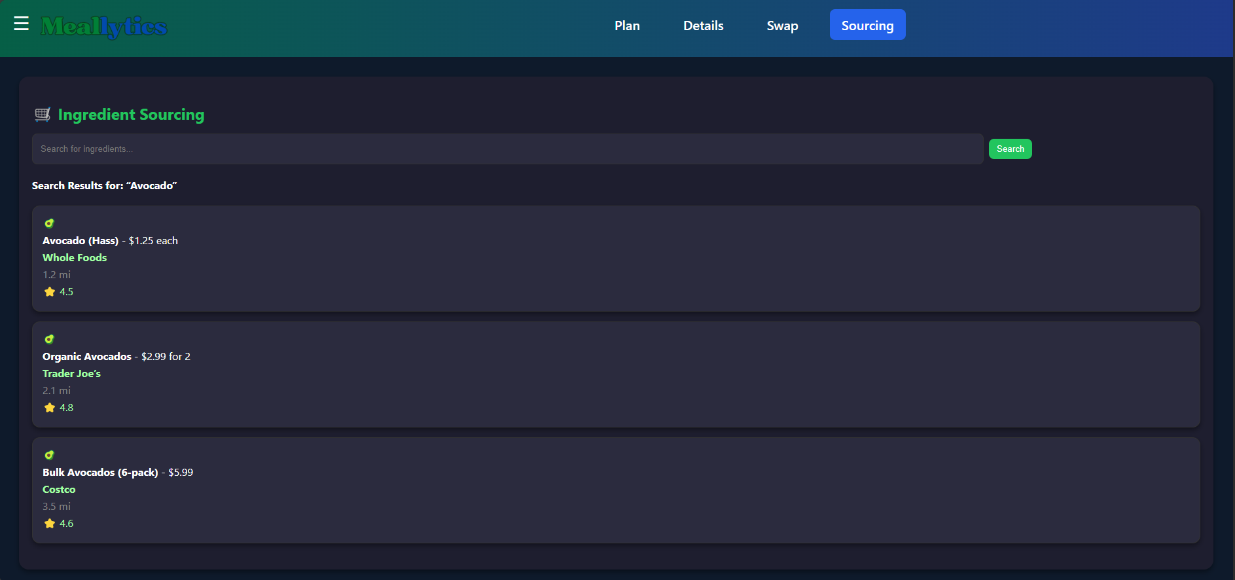
Ingredient Sourcing

Slide 24

Nutrition Insights

Slide 25
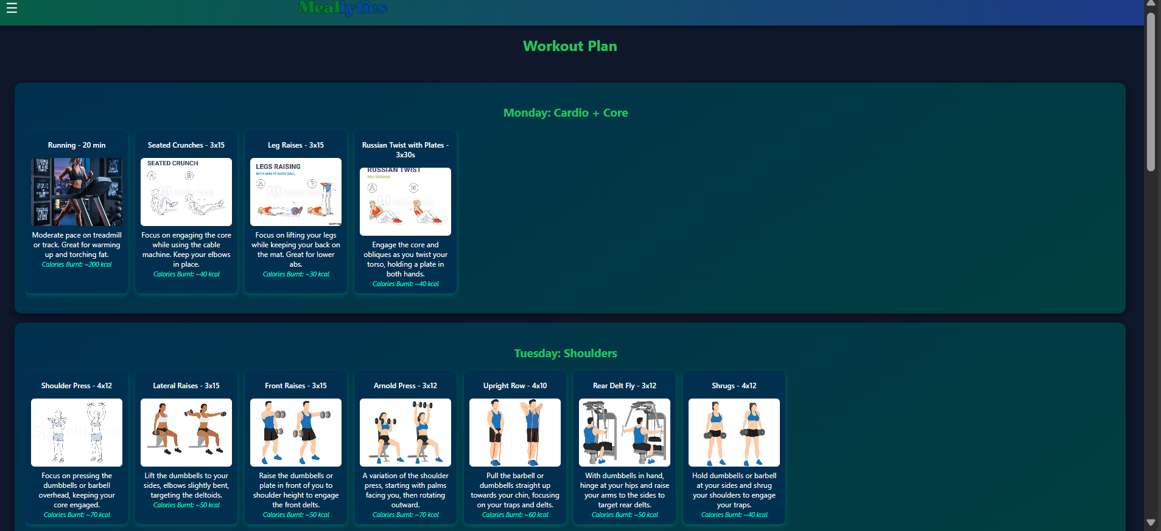
Fitness Plan

Slide 26
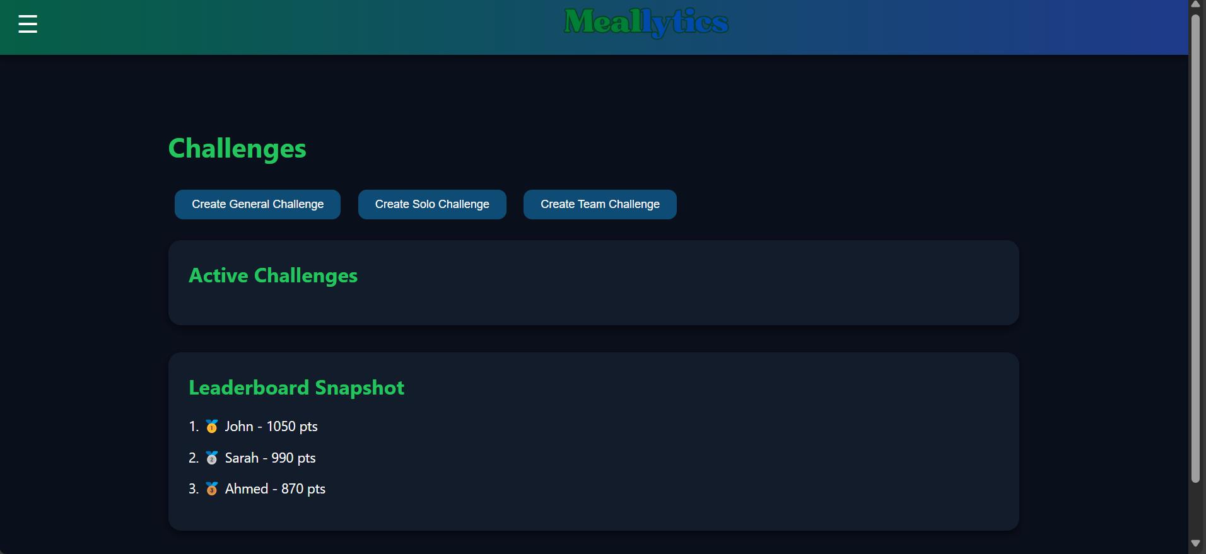
Challenges

Slide 27
Cost Estimation

Slide 28
Why We Chose the Semi-Detached Model
Our system uses AI, making it moderately complex and technically demanding.
This level of complexity fits the Semi-Detached COCOMO model, ideal for medium-sized projects needing experienced developers and some supervision.

Slide 29
📊 Estimation Results Using Basic COCOMO
Estimated Effort: ~70 person-months
Estimated Development Time: ~11 months
Estimated Team Size: ~6 developers

Slide 30
Conclusion
AI + gamification = powerful health tool
Encourages long-term healthy behavior
Sync with wearable devices, more real-time feedback
Notes:
Hena bntklm 3ala problem w el motivation el project aslan

Slide 31
Thank You!
Do you have any questions?

